Slide 1
TCP
Reno NewReno SACK
Kulan Kao
2006/3/25

Slide 2
TCP congestion control
There are five stages in the congestion control mechanisms of TCP
  Slow-start
  Congestion avoidance
  Fast retransmission
  Fast recovery
  Timeout retransmission

Slide 3
TCP
Tahoe: Slow start, congestion avoidance and fast retransmit
Reno: Tahoe + fast recovery
New-Reno: Reno with modified fast recovery
SACK: Reno + selective ACKs

Slide 4
TCP Reno, RFC 2001
TCP Reno has Slow Start, Congestion Avoidance, Fast Retransmit, and Fast Recovery Algorithms
When a new connection is established with a host on another network, the congestion window is initialized to 1 segment
  the segment size announced by the other end, or the default, typically 536 or 512 bytes.

Slide 5
TCP Reno, RFC 2001
Slow-start
Each time an ACK is received, the congestion window is increased by 1 segment.
The sender can transmit up to the minimum of the congestion window and the advertised window.
The congestion window is flow control imposed by the sender, based on the sender's assessment of perceived network congestion
while the advertised window is flow control imposed by the receiver, related to the amount of available buffer space at the receiver for this connection.

Slide 6
TCP Reno, RFC 2001
Slow-start
The sender starts by transmitting 1 segment and waiting for its ACK. When that ACK is received, the congestion window is incremented from 1 to 2, and 2 segments can be sent.
cwnd=1 in first RTT (round-trip-time), cwnd=2 in second RTT, cwnd=4 in third RTT, cwnd is increasing exponentially

Slide 7
TCP Reno, RFC 2001
Slow-start
Initialization for a given connection sets cwnd to 1 segment and sets ssthresh to 65535 bytes.
The TCP output routine never sends more than the minimum of cwnd and the receiver's advertised window.
When congestion occurs (indicated by a timeout or the reception of duplicate ACKs), 1/2 of the current window size (the minimum of cwnd and the receiver's advertised window, but at least 2 segments) is saved in ssthresh.
  if the congestion is indicated by a timeout, cwnd is set to 1 segment (i.e., slow start).

Slide 8
TCP Reno, RFC 2001
Slow-start
When new data is acknowledged by the other end, increase cwnd, but the way it increases depends on whether TCP is performing slow start or congestion avoidance.
  If cwnd is less than or equal to ssthresh, TCP is in slow start
  otherwise TCP is performing congestion avoidance.
Slow start continues until TCP is halfway to where it was when congestion occurred (since it recorded 1/2 of the window size that caused the problem in step 2), and then congestion avoidance takes over.

Slide 9
TCP Reno, RFC 2001
Congestion avoidance
Congestion avoidance dictates that cwnd be incremented by segsize*segsize/cwnd each time an ACK is received, where segsize is the segment size and cwnd is maintained in bytes.
  cwnd=128 in n^{th} RTT, cwnd=129 in n+1th RTT, cwnd=130 in n+2th RTT, cwnd is increasing linearly
During Congestion avoidance, the increase in cwnd should be at most 1 segment each round-trip time (regardless how many ACKs are received in that RTT), whereas slow start increments cwnd by the number of ACKs received in a round-trip time.

Slide 10
TCP Reno, RFC 2001
Fast Retransmit
TCP Reno may generate an immediate acknowledgment (a duplicate ACK) when an out-of-order segment is received.
This duplicate ACK should not be delayed. The purpose of this duplicate ACK is to let the other end know that a segment was received out of order, and to tell it what sequence number is expected.
Since TCP does not know whether a duplicate ACK is caused by a lost segment or just a reordering of segments, it waits for a small number of duplicate ACKs to be received

Slide 11
TCP Reno, RFC 2001
Fast Retransmit
It is assumed that if there is just a reordering of the segments, there will be only 1 or 2 duplicate ACKs before the reordered segment is processed, which will then generate a new ACK.
If 3 or more duplicate ACKs are received in a row, it is a strong indication that a segment has been lost. TCP then performs a retransmission of what appears to be the missing segment, without waiting for a retransmission timer to expire.

Slide 12
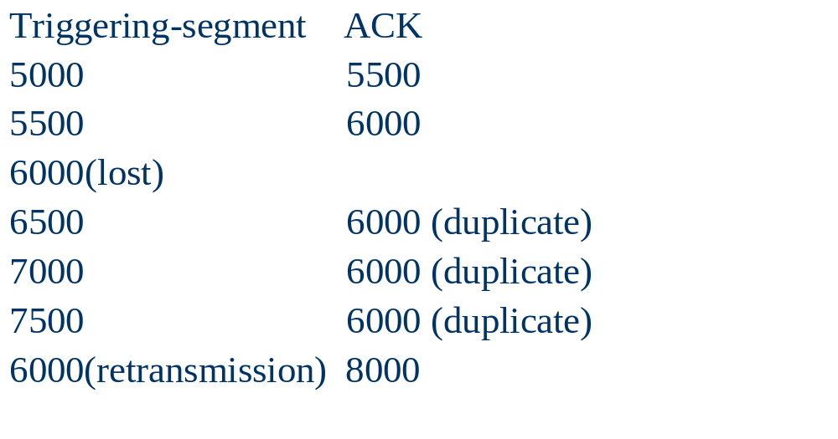
Example of Duplicate ACKs

Slide 13
TCP Reno, RFC 2001
Fast Recovery
After fast retransmit sends what appears to be the missing segment, congestion avoidance, but not slow start is performed. This is called the fast recovery algorithm.
Since the receiver can only generate the duplicate ACK when another segment is received, that segment has left the network and is in the receiver's buffer. That is, there is still data flowing between the two ends, and TCP does not want to reduce the flow abruptly by going into slow start.

Slide 14
TCP Reno, RFC 2001
Fast Recovery
When the 3rd duplicate ACK is received, set ssthresh to 1/2 the current congestion window, cwnd, but no less than 2 segments.
Retransmit the missing segment. Set cwnd to ssthresh plus 3 times the segment size. This inflates the congestion window by the number of segments that have left the network and which the other end has cached.
Each time another duplicate ACK arrives, increment cwnd by 1 segment. This inflates the congestion window for the additional segment that has left the network.

Slide 15
TCP Reno, RFC 2001
Fast Recovery
When the next ACK arrives that acknowledges new data, set cwnd to ssthresh (the value in step 1 set ssthresh to 1/2 the current congestion window).

Slide 16
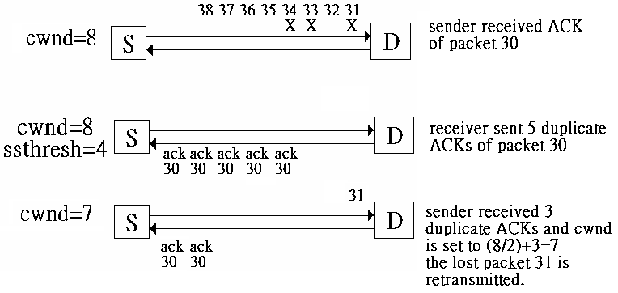
A TCP Reno Example

Slide 17
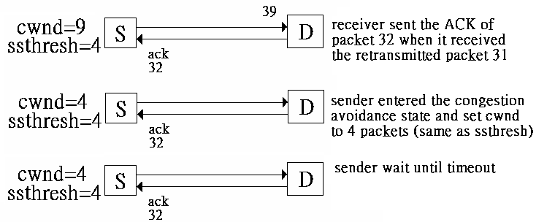
A TCP Reno Example

Slide 18
Drawbacks of TCP Reno
TCP Reno have to wait until timeout before retransmit lost packet, because Reno will finish Fast recovery and enter congestion avoidance stage when sender receive Partial ACK.
But during this waiting time, some packet still missed.

Slide 19
Drawbacks of TCP Reno
When TCP Reno sender back to congestion avoidance stage, there are usually no enough duplicate ACK to trigger retransmission mechanism, so sender can only wait until timeout.
Timeout affect TCP efficiency heavily, because TCP cannot send out new packet when waiting timeout and cwnd will be set to 1 after timeout.

Slide 20
NewReno, RFC2582
Fast Retransmit / Recovery
TCP NewReno will not finish Fast recovery when sender receives Partial ACK
On the contrary, sender will continuously retransmit those packet after Partial ACK, until all lost packet being retransmit, then finish Fast recovery.
TCP NewReno can retransmit 1 lost packet every RTT time during Fast recovery stage, which improve the usage of link.

Slide 21
NewReno, RFC2582
Fast Retransmit / Recovery
When the 3rd duplicate ACK is received and the sender is not already in the Fast Recovery procedure, set ssthresh to no more than the value given in equation 1 below.
ssthresh = max (FlightSize / 2, 2*MSS) (1)
  Flight Size: The amount of data that has been sent but not yet acknowledged.
  MSS: the Maximum Segment Size specified by the receiver to the sender (or the default value of 536 bytes, if the receiver does not specify an MSS option during connection establishment).
Record the highest sequence number transmitted in the variable "recover".

Slide 22
NewReno, RFC2582
Fast Retransmit / Recovery
Retransmit the lost segment and set cwnd to ssthresh plus 3*MSS(maximal segment size).
For each additional duplicate ACK received, increment cwnd by 1 MSS.
Transmit a segment, if allowed by the new value of cwnd and the receiver's advertised window
When an ACK arrives that acknowledges new data, this ACK could be the acknowledgment elicited by the retransmission from step 2, or elicited by a later retransmission.

Slide 23
NewReno, RFC2582
Fast Retransmit / Recovery
If this ACK acknowledges all of the data up to and including "recover", then the ACK acknowledges all the intermediate segments sent between the original transmission of the lost segment and the receipt of the 3rd duplicate ACK. Set cwnd to either
  min (ssthresh, FlightSize + MSS); or
  ssthresh, where ssthresh is the value set in step 1; this is termed "deflating" the window.
If not the case, retransmit the first unacknowledged segment. Deflate the congestion window by the amount of new data acknowledged, then add back 1 MSS and send a new segment if permitted by the new value of cwnd.

Slide 24
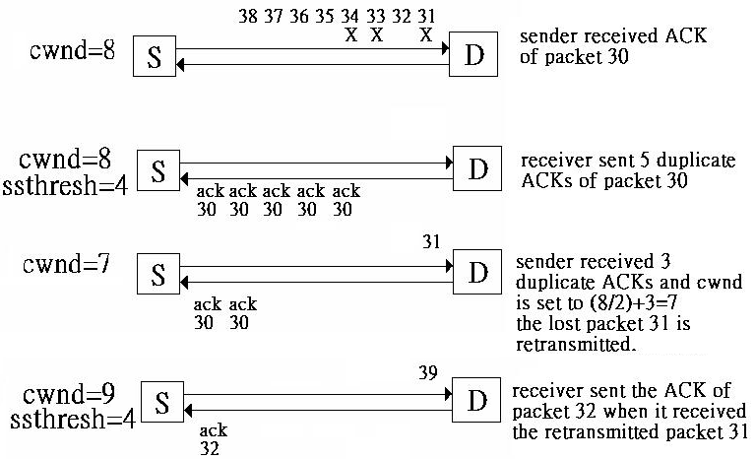
A TCP NewReno example

Slide 25
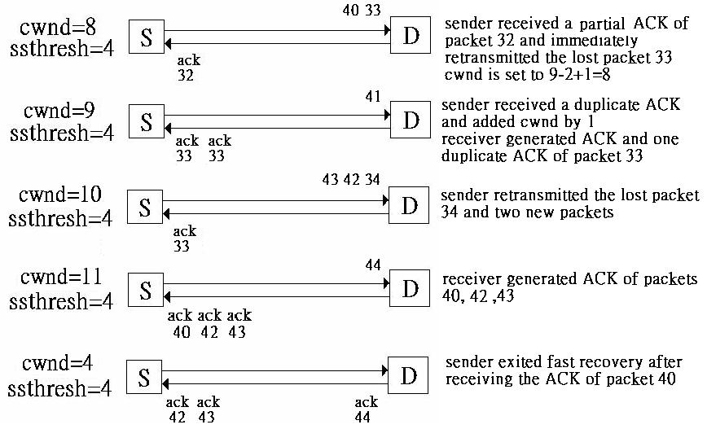

Slide 26
TCP SACK, RFC2018
Although NewReno can solve multiple packet loss, only 1 lost packet can be recovery every RTT time.
A Selective Acknowledgment(SACK) mechanism, combined with a selective repeat retransmission policy, can help to overcome these limitations
TCP SACK include a SACK option which permit receiver to inform sender which period of data is not received during transmitting Duplicate ACK.

Slide 27
TCP SACK
According to these information, TCP SACK sender can know which packet was received and which packet should be retransmitted.
Though, TCP SACK sender can send more than one packet in one RTT period time.

Slide 28
TCP SACK, RFC2018
If the data receiver choose to send a SACK option, the following rules apply:
1.The first SACK block MUST specify the contiguous block of data containing the segment which triggered this ACK.
2.The data receiver Should include as many distinct SACK blocks as possible in the SACK option.
3.The SACK option should be filled out by repeating the most recently reported SACK blocks that are not subsets of a SACK blocks already included in the SACK options being constructed.

Slide 29
SACK, RFC2018
The SACK option is to be sent by a data receiver to inform the data sender of non-contiguous blocks of data that have been received and queued.
The data receiver awaits the receipt of data (perhaps by means of retransmissions) to fill the gaps in sequence space between received blocks.
When missing segments are received, the data receiver acknowledges the data normally by advancing the left window edge in the Acknowledgement Number Field of the TCP header.

Slide 30
SACK, RFC2018
This SACK option contains a list of some of the blocks of contiguous sequence space occupied by data that has been received and queued within the window.
Each contiguous block of data queued at the data receiver is defined in the SACK option by two 32-bit unsigned integers in network byte order:
  Left Edge of Block
    This is the first sequence number of this block.
  Right Edge of Block
    This is the sequence number immediately following the last sequence number of this block.

Slide 31
Examples of TCP SACK
Assume the left window edge is 5000 and that the data transmitter sends a burst of 8 segments, each containing 500 data bytes.
Case 1: The first 4 segments are received but the last 4 are dropped.
  The data receiver will return a normal TCP ACK segment acknowledging sequence number 7000, with no SACK option.

Slide 32
Examples of TCP SACK
Case 2: The first segment is dropped but the remaining 7 are received.
  Upon receiving each of the last seven packets, the data receiver will return a TCP ACK segment that acknowledges sequence number 5000 and contains a SACK option specifying one block of queued data:

Slide 33
Examples of TCP SACK
Triggering ACK Left Edge Right Edge
Segment
5000 (lost)
5500 5000 5500 6000
6000 5000 5500 6500
6500 5000 5500 7000
7000 5000 5500 7500
7500 5000 5500 8000
8000 5000 5500 8500
8500 5000 5500 9000

Slide 34
Examples of TCP SACK
Case 3: The 2nd, 4th, 6th, and 8th (last) segments are dropped.
  The data receiver ACKs the first packet normally. The third, fifth, and seventh packets trigger SACK options as follows:

Slide 35
Examples of TCP SACK
Triggering ACK First Block 2nd Block 3rd Block
Segment Left Right Left Right Left Right Edge Edge Edge Edge Edge Edge
5000 5500
5500 (lost)
6000 5500 6000 6500
6500 (lost)
7000 5500 7000 7500 6000 6500
7500 (lost)
8000 5500 8000 8500 7000 7500 6000 6500
8500 (lost)

Slide 36
Examples of TCP SACK
Suppose at this point, the 4th packet(6500) is received out of order. The data receiver has only two SACK blocks to report. The data receiver replies with the following Selective Acknowledgment:
Triggering ACK First Block 2nd Block 3rd Block
Segment Left Right Left Right Left Right Edge Edge Edge Edge Edge Edge
6500 5500 6000 7500 8000 8500

Slide 37
Examples of TCP SACK
Suppose at this point, the 2nd segment is received. The data receiver then replies with the following Selective Acknowledgment
Triggering ACK First Block 2nd Block 3rd Block
Segment Left Right Left Right Left Right Edge Edge Edge Edge Edge Edge
5500 7500 8000 8500

Slide 38
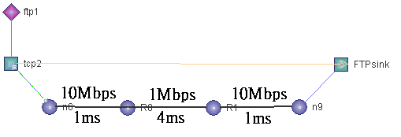
Exp9.tcl
Buffer size=15

Slide 39
Exp9.tcl
Example 1
  Variation of TCP Reno congestion window.
Example 2
  Variation of TCP NewReno congestion window
Example 3
  Variation of TCP SACK congestion window

